Slide 1
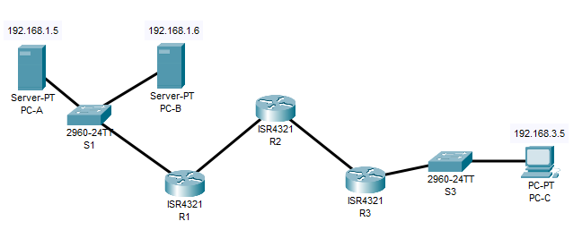
TOPOLOGIA

Slide 2
Packet Tracer - Configure OSPF Authentication
R1
R1(config)# router ospf 1
R1(config-router)# area 0 authentication message-digest
R1(config)# interface g0/0/0
R1(config-if)# ip ospf message-digest-key 1 md5 MD5pa55

Slide 3
Packet Tracer - Configure OSPF Authentication
R2
R2(config)# router ospf 1
R2(config-router)# area 0 authentication message-digest
R2(config)# interface g0/0/0
R2(config-if)# ip ospf message-digest-key 1 md5 MD5pa55
R2(config-if)# interface g0/0/1
R2(config-if)# ip ospf message-digest-key 1 md5 MD5pa55

Slide 4
Packet Tracer - Configure OSPF Authentication
R3
R3(config)# router ospf 1
R3(config-router)# area 0 authentication message-digest
R3(config)# interface g0/0/1
R3(config-if)# ip ospf message-digest-key 1 md5 MD5pa55

